Slide 1
Introduction to Web Mapping

Slide 2
So, what is a web map?

Slide 3
Downloadable PDFs…
Static Images (.jpg etc…)
Interactive Mapping Applications…

Slide 4
for our purposes… an interactive mapping application generally using a JavaScript framework to facilitate the basic pan, zoom and identify workflows native to interactive web mapping.

Slide 5
Data

Slide 6
The Mapping Client

Slide 7
Contextual Data aka… Base Maps

Slide 8
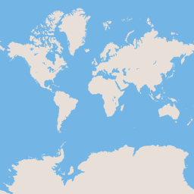
Tiles…
256 px
256 px

Slide 9
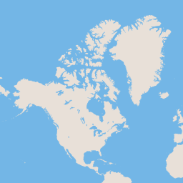
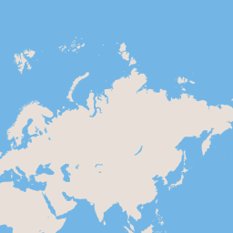
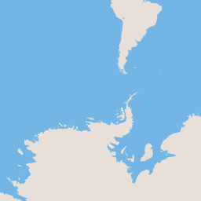
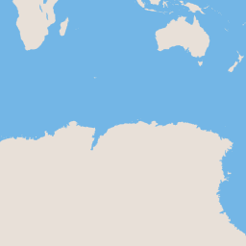
Tiles…
256 px
z0
z1
256 px
and so on…

Slide 10
https://a.tiles.mapbox.com/v4/examples/{z}/{x}/{y}.png

Slide 11
Topical Data tells the story

Slide 12
WMS (web mapping service)
WFS (web feature service)
kml
csv
geoJSON

Slide 13
Java- Script Object Notation
{
‘no’:1,
‘type’:’college’,
‘name’:’KSU’
}

Slide 14
http://geojson.org/
{
"type": "Feature",
"geometry": {
"type": "Point",
"coordinates": [125.6, 10.1]
},
"properties": {
"name": "Dinagat Islands"
}
}

Slide 15
The Mapping Client the software that puts it all together

Slide 16
Google Maps JavaScript API
ESRI ArcGIS JavaScript API
MapBox JavaScript API
Leaflet
OpenLayers
many others...

Slide 17


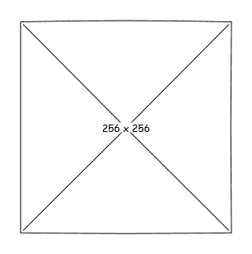
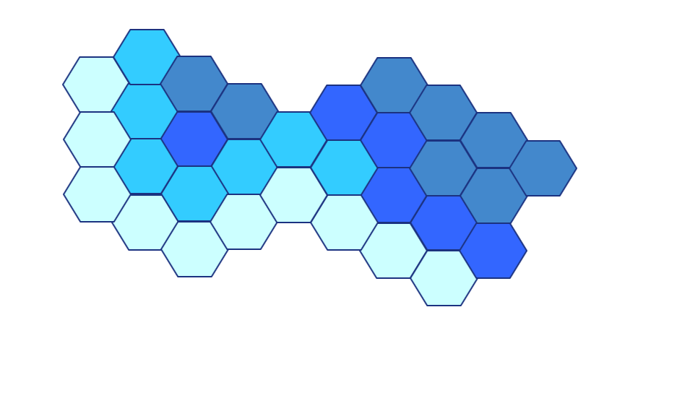

Slide 18
SVG
Canvas
Plain Images…

Slide 19
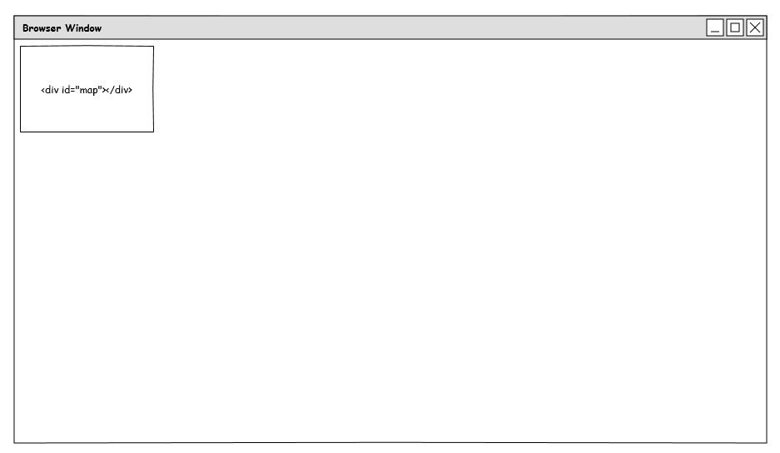
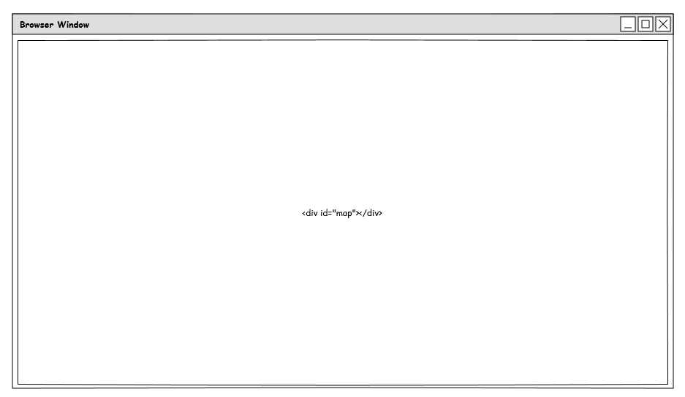
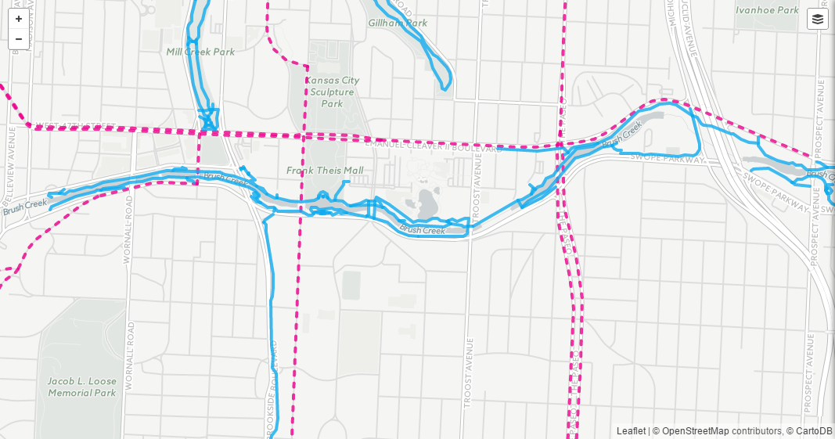
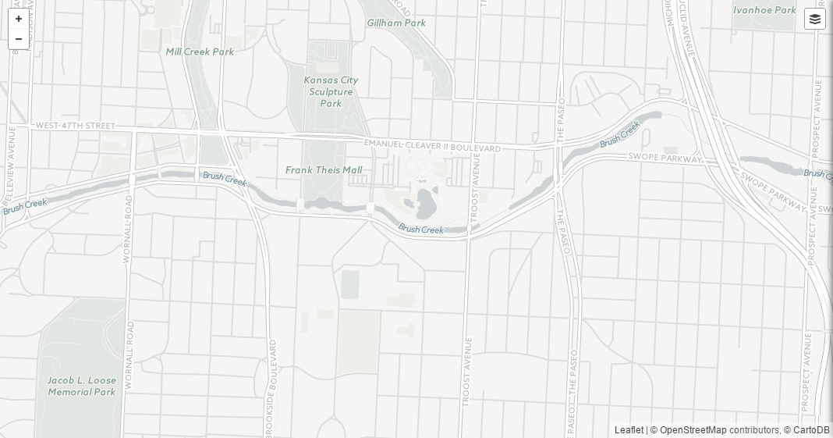

Slide 20
Let’s Make A Map!

Slide 21
Base Map mapbox.com

Slide 22
Hosting github.com

Slide 23
Data geojson.io overpass-turbo.eu

Slide 24
fork my repo https://github.com/willbreitkreutz/web_mapping_workshop

Slide 25
{your_user_name} .github.io/ {repository_name}
gh-pages

